Slide 1
Project Title
Student Names, XXX, XXX
Dec. 5 or 7, 2017

Slide 2
Problem Statement
Same as from Mid-term Presentation

Slide 3
Starting Concept
Weighted Average Decision
Features
Number of Parts
Rough Size or
Drawing or block diagram
Picture or sketch

Slide 4
Impact Statement*
Explain the impact of your design in terms of solving a problem and its impact on society [paragraph or points]
* New

Slide 5
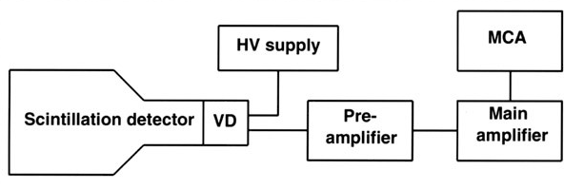
Blocks and Lines Diagram
Simple Block Diagram:

Slide 6
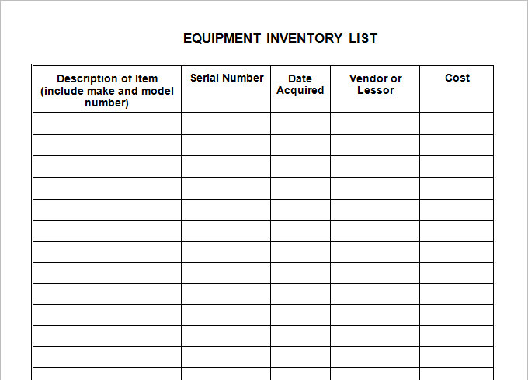
Master Equipment List

Slide 7
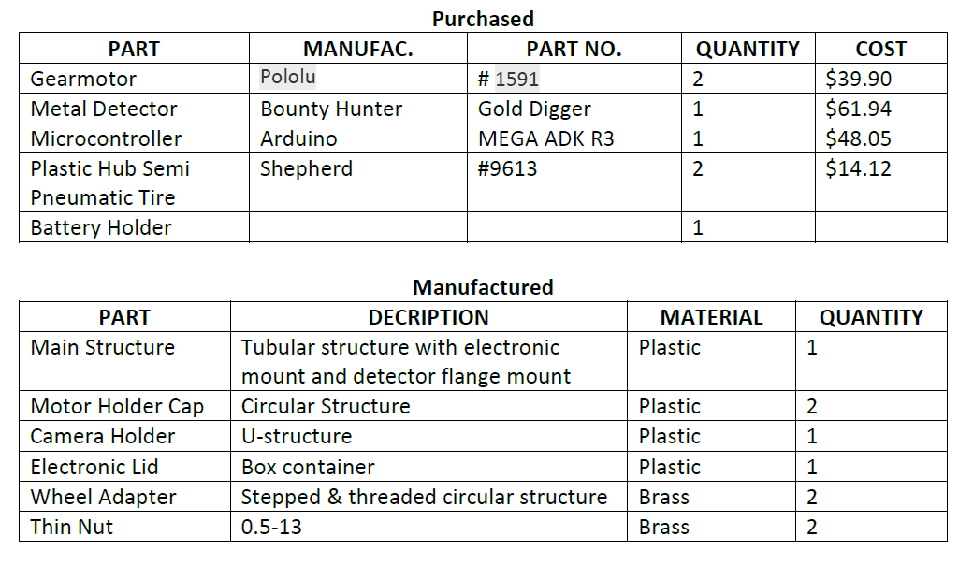
Or a Simple Parts List

Slide 8
Risk Analysis
5 Near Certainty
High Risk
l
l
4 Highly Probable
Moderate Risk
3 Likely
Likelihood
2 Unlikely
1 Negligible
Low Risk
1 Marginal
2 Significant
3 Serious
4 Very Serious
5 Catastrophic
Consequence

Slide 9
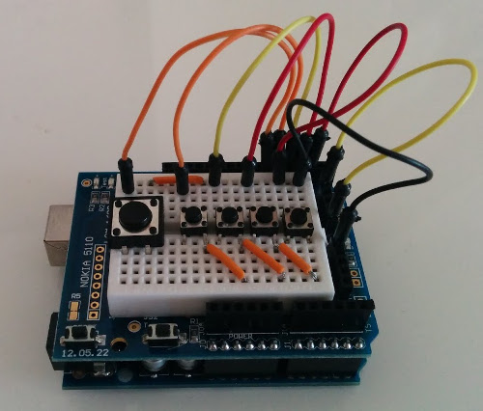
Example of Development
Hardware demonstration or photographs of development

Slide 10
Architecture
DeMarco or Hatley/Pirbhai
Level 0
Level 1
etc.
Annotated
Map
Operator
Command
0.
Scan Area
Robot
Level 0

Slide 11
Data Flow Diagram
base
compute
triangle
area
area
height

Slide 12
Electrical Analysis
Bullets or Diagrams

Slide 13
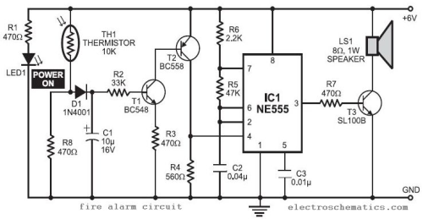
Electrical Detail Design

Slide 14
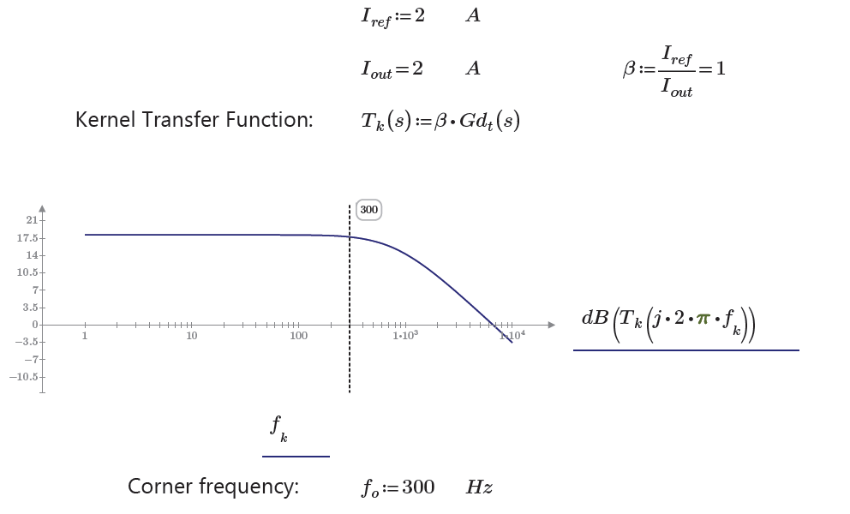
Power Analysis

Slide 15
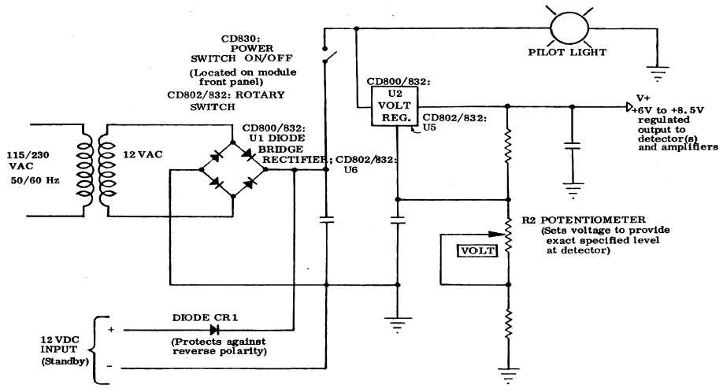
Power Detail Design

Slide 16
Project Summary
Bullets

Slide 17
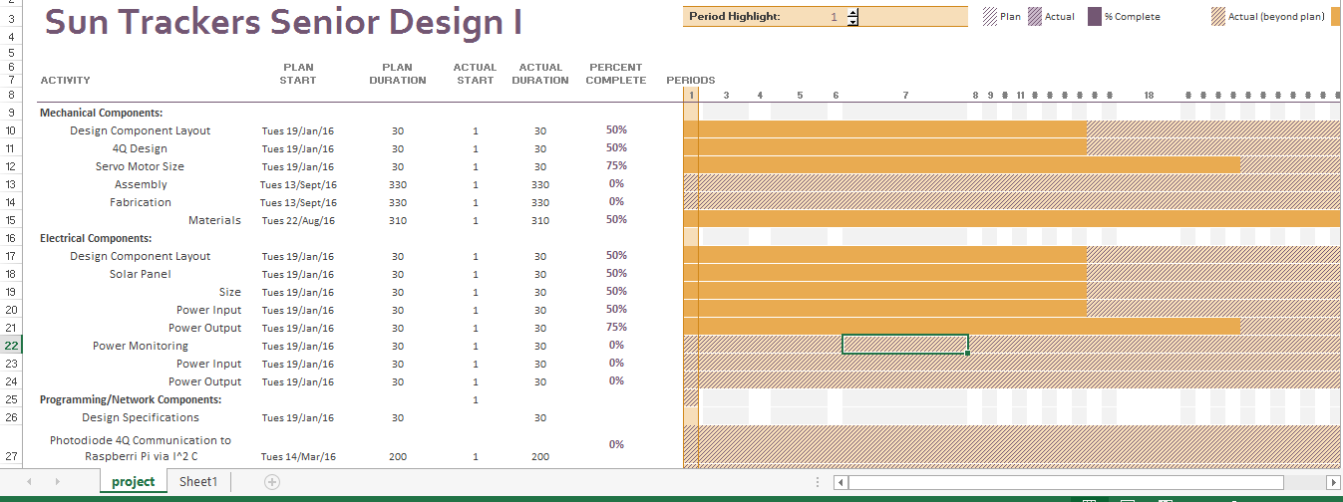
Project Gantt Chart for Senior Design II
Status of Project including milestones

Slide 18
Any questions?

